Slide 1

training & research
for academic newcomers
A project of the King Baudouin Foundation
Notes:
Please use this slide at the beginning of your presentation.
Background color: red-120; green-150; blue-150; transparancy-80%

Slide 2

Negotiation And Legal Documents
Gabriella Calderari
David W Chadwick
Notes:
If you want you can use this template for you presentation, see potx-file.

Slide 3
OVERVIEW
Negotiation
Grant Agreement
Consortium Agreement
Background/foreground IPR

Slide 4
NEGOTIATION PHASE AND LEGAL FRAMEWORK
They are essentially linked and usually take place in parallel.
Financial
Negotiations
Technical Negotiations
Notes:
If you want you can use this template for you presentation, see potx-file.

Slide 5
To agree on the final content of the DoW including:
Addressing the comments made in the ESR
Verifying that the project objectives are SMART (S-Specific, M-Measurable, A-Attainable, R-Realistic, T-Timely)
The list of deliverables, their timing, content and dissemination level
The project milestones and their assessment criteria
An indicative time schedule for the reporting and the project reviews.
TECHNICAL NEGOTIATIONS
Notes:
ERS Evaluation Summary Report

Slide 6
To agree on budgetary/partnership matters including:
Budget for full duration of project
Budget breakdown per period
Subcontracting and third party issues
The pre-financing
The analysis and review of the legal status of each participant
The capacity of the Coordinator to fulfil this role
The start date of the project
Any special clauses required
LEGAL & FINANCIAL NEGOTIATIONS
Notes:
If you want you can use this template for you presentation, see potx-file.

Slide 7
GRANT AGREEMENT
Contract including agreed workplan of activities, budget allocation to partners, financial issues and reporting periods and procedures.
Parts: European Commission and Coordinator.
Coordinator signs contract with partners who are bound to fulfil all the obligations included in the approved workplan.
Notes:
If you want you can use this template for you presentation, see potx-file.

Slide 8
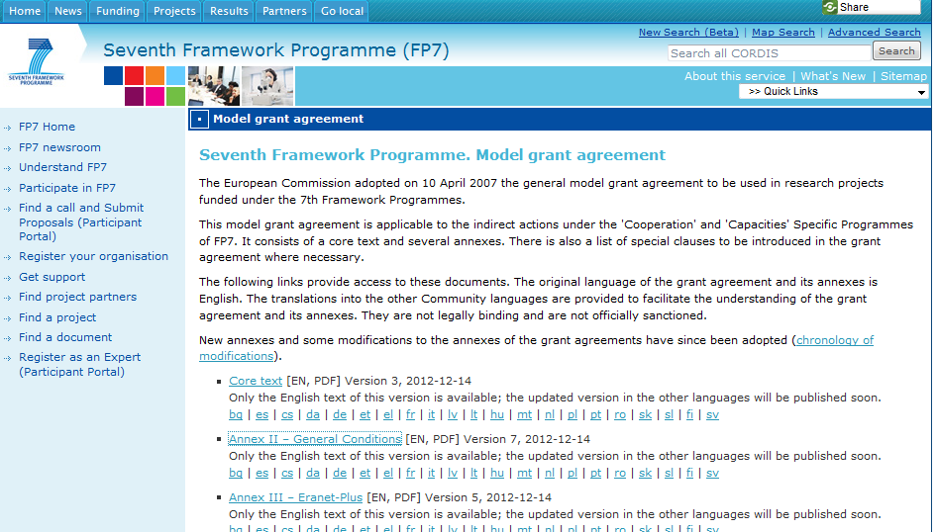
http://cordis.europa.eu/fp7/calls-grant-agreement_en.html

Slide 9
Model G.A. Structure
Annex II – General Conditions
Annex III – Eranet-Plus
Annex III – Infrastructures
Annex III – SME actions
Annex III – Civil Society Organisations
Annex IV – Form A
Annex V – Form B
Annex VI – Form C for CP
Annex VI – Form C for CSA
Annex VI – Form C for combination of CP and CSA
Annex VI – Form C for NoE
Annex VI – Form C for BSG-SME
Annex VI – Form C for CSA-Eranet-Plus
Annex VII – Form D
Annex VII – Form E
List of special clauses
Core Contract
Contains specific information regarding the project: start date e duration, EC maximum contribution, reporting periods, participants list and “special clauses” (if applicable)

Slide 10
Most important documents
Annex I - Description of Work
Annex II - General conditions
Annex III - Specific provisions
Annex IV - Form A – Accession of beneficiaries to the grant agreement
Annex V - Form B – Request for accession of a new beneficiary to the grant agreement
Annex VI - Form C – Financial statement per funding scheme
Annex VII - Form D – Terms of reference for the certificate on the financial statements
Form E - Terms of reference for the certificate on the methodology
Notes:
If you want you can use this template for you presentation, see potx-file.

Slide 11
ANNEX I
The DoW forms Annex I to the Grant Agreement.
It is based on part B of the proposal, following the same basic layout and is similar for all funding schemes.
Is comprised of two parts:-
Part A = List of Participants, Copies of the budget breakdown (GAPF Form A3.2) and Project Summary, Forms (GAPF Form A1).
Part B = Based on Part B of the proposal
Notes:
If you want you can use this template for you presentation, see potx-file.

Slide 12
ANNEX II General Conditions
Part A IMPLEMENTATION OF THE PROJECT
SECTION 1 – GENERAL PRINCIPLES
SECTION 2 – REPORTING AND PAYMENTS
SECTION 3 – IMPLEMENTATION
Part B FINANCIAL PROVISIONS
SECTION 1 – GENERAL FINANCIAL PROVISIONS
SECTION 2 – GUARANTEE FUND AND RECOVERIES
SECTION 3 – CONTROLS AND SANCTIONS
Part C INTELLECTUAL PROPERTY RIGHTS, USE AND DISSEMINATION
SECTION 1 – FOREGROUND
SECTION 2 – ACCESS RIGHTS
FINAL PROVISIONS

Slide 13
CONSORTIUM AGREEMENT (CA)
The CA is an agreement made between participants to govern a number of issues that will or may arise during the project. It applies to all the contractors participating in the project covered by the contract.
Notes:
If you want you can use this template for you presentation, see potx-file.

Slide 14
Consortium Agreement (CA)
A consortium agreement is required for all projects financed under FP7 except those exempted from this obligation by the call for proposals to which they have applied.
The Community is not a party to any CA and does not establish the terms and conditions of the CA but it issues guidelines for development
In principle, the CA should be negotiated and signed before starting the project.

Slide 15
CA structure
General Information on project
2. Technical Provisions and the internal organisation of the consortium
3. Financial and Legal Provisions
4. Management of Intellectual Property Rights
5. The settlement of internal disputes.

Slide 16
Technical provisions
  Technical contribution of each party (as set out in Annex 1)
  Technical resources made available
  Project Schedule
  Expected contribution, maximum effort expected, modification procedure
  Provisions for dealing with non-performing contractor (s)
Notes:
If you want you can use this template for you presentation, see potx-file.

Slide 17
Financial provisions
  Financing plan
  Modification procedure
  Mutual payments, common costs
  Distribution of management costs
  Auditing of costs and Audit certificates
  Provisions for dealing with non-performing contractor(s)
  Third party resources - identifying parties and resources
Notes:
If you want you can use this template for you presentation, see potx-file.

Slide 18
Commercial provisions
  Confidentiality
  Ownership of results / joint ownership of results / difficult cases (background knowledge that is very closely linked to the result, making it difficult to distinguish the background from the results)
  Legal protection of results (patent rights)
  Commercial exploitation of results and any necessary access rights
  Commercial obligations
  Relevant patents, know-how, and information
  Sub-licensing
Notes:
If you want you can use this template for you presentation, see potx-file.

Slide 19
BACKGROUND AND FOREGROUND
BACKGROUND INTELLECTUAL PROPERTY
Intellectual property developed independently by each individual company prior to entering into the collaboration relationship
PROJECT
new intellectual property which is developed arising out of a relationship between two companies collaborating together
FOREGROUND INTELLECTUAL PROPERTY

Slide 20
Background’ and ‘Foreground’ IPRs
  Specification & descriptions of background IP and arrangements for its use during the project
  Allocation and exercise of ownership in foreground IP, including joint ownership; and agreement on its use during the project, and afterwards.
  For joint ownership of foreground IP, designation of a lead institution to deal with it on behalf of the other parties.
  Exploitation of IP produced by the consortium for the benefit of all parties.
Notes:
E.g. prototype

Slide 21
Thank you!
gabriella.calderari@uniroma1.it
d.w.chadwick@kent.ac.uk

